Slide 1
Modeling Frames of Reference and Coordinate Systems with SysML
Prepared by the MBSE Coordinate System WG and the Telescope Modeling Challenge Team

Slide 2
Outline
Motivation
Requirements
Definition
Standards
Real-World Examples (without SysML)
SysML Modeling Examples (FireSat)
Modeling
Modeling Options
Relations to State Analysis’ Graph State Variables

Slide 3
Motivation
Descriptions of (Opto)-Mechanical Systems require frames of reference and coordinate systems to define static absolute and relative positions
Control of (Opto)-Mechanical Systems requires frames of reference and coordinate systems to define Sensor and Actuators spaces, their relations, and their transformations

Slide 4
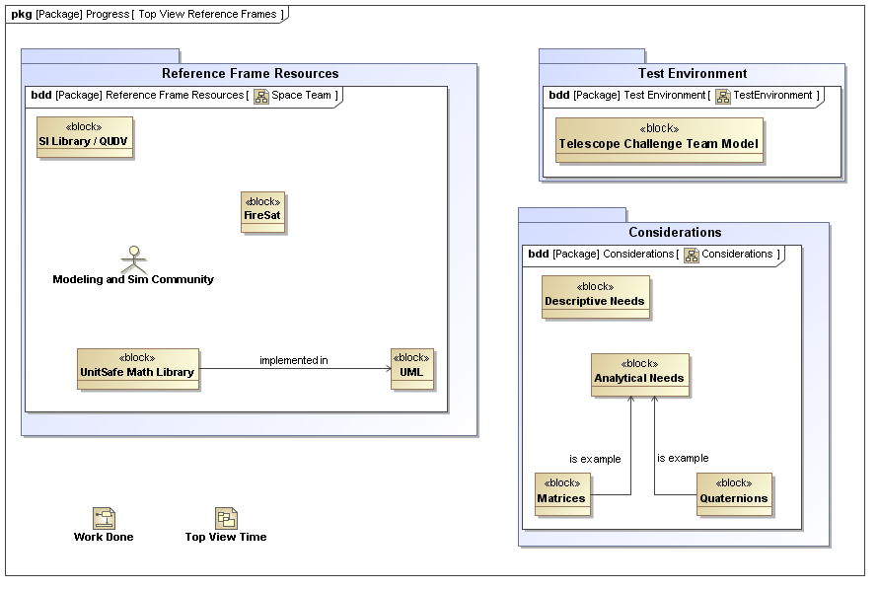
Context from INCOSE IW11

Slide 5
Requirements
An Ontology and SysML profile to define frames of reference and coordinate systems shall be defined.
The definition of the frames of reference and coordinate systems shall be integrated in the overall system model
The definition of coordinate systems and frames of reference shall be modeled independently of model elements of the system under design; i.e. the model elements of the system under design shall remain unchanged when modeling the coordinate system, yet they shall be referenced.
The modeling approach shall permit multiple frames of reference and coordinate system for each system element.
The modeling approach shall permit to describe relations and transformations between coordinate systems; e.g. with Euler angles
The modeling concepts shall consider implementation issues, like performance of coordinate system transformation

Slide 6
Use Cases
TBD

Slide 7
Concepts
Observational frames of reference Used when emphasis is upon the state of motion rather than upon the coordinate choice or the character of the observations or observational apparatus. In this sense, an observational frame of reference allows study of the effect of motion upon an entire family of coordinate systems that could be attached to this frame.
Coordinate systems A mathematical concept, amounting to a choice of language used to describe observations. An observer in an observational frame of reference can choose to employ any coordinate system (Cartesian, polar, curvilinear, generalized, …) to describe observations made from that frame of reference. A change in the choice of this coordinate system does not change an observer's state of motion, and so does not entail a change in the observer's observational frame of reference. There is no necessary connection between coordinate systems and physical motion (or any other aspect of reality). However, coordinate systems can include time as a coordinate, and can be used to describe motion. In engineering, they could be angles of relative rotations, linear displacements, or deformations of joints.
Observational equipment Choice of what to measure and with what observational apparatus is a matter separate from the observer's state of motion and choice of coordinate system.

Slide 8
Roadmap
Define Ontology of frames of reference and coordinate systems (existing Java libraries could be used as starting point)
Define mapping of Ontology to SysML profile
Provide simple application of profile
Apply profile to telescope example

Slide 9
Coordinate System
In geometry, a coordinate system is a system which uses one or more numbers, or coordinates, to uniquely determine the position of a point or other geometric element. E.g. Cartesian, Polar Coordinates

Slide 10
Observational frame of reference
An observer in an observational frame of reference can choose to employ any coordinate system (Cartesian, polar, curvilinear, generalized, …) to describe observations made from that frame of reference. A change in the choice of this coordinate system does not change an observer's state of motion, and so does not entail a change in the observer's observational frame of reference. An observational frame of reference is characterized only by its state of motion.
An inertial frame of reference is defined as one in which all laws of physics take on their simplest form.
A non-inertial frame of reference is one in which fictitious forces must be invoked to explain observations. An example is an observational frame of reference centered at a point on the Earth's surface. This frame of reference orbits around the center of the Earth, which introduces a fictitious force known as the Coriolis force
A further aspect of a frame of reference is the role of the measurement apparatus (for example, clocks and rods) attached to the frame.
In physics experiments, the frame of reference in which the laboratory measurement devices are at rest is usually referred to as the laboratory frame or simply "lab frame." An example would be the frame in which the detectors for a particle accelerator are at rest. The lab frame in some experiments is an inertial frame, but it is not required to be.

Slide 11
DoD Navy Definitions
Frames of reference are characterized by several major properties: an origin, reference lines, reference planes, and stability
Origin.
To be useful for measuring linear distances, a reference frame must have a reference point of origin that establishes
the zero point for the frame. A distance of 100 yards has meaning within the frame since it is understood that the
measured distance is relative to the frame's origin.
Reference lines
In weapon systems, target direction from the origin is measured in angular quantities. To give meaning and a zero reference to
angular quantities, reference lines are established. Reference lines pass through the origin and establish the axes of
the reference frame.
Reference planes
In addition to reference lines, angular measurements require the definition of planes in which angles are to be
measured. For example, an object located a distance of 100 yards from the origin and 45o from a reference line has
virtually an infinite possibility of actual locations unless the plane in which the angle is measured is defined
Stability
A truly stable or inertial reference frame is one that is held fixed or nonrotating with respect to the distant stars. In this type of reference frame, target motion is very easily described since all changes in target position within the frame are due only to the motion of the target itself. An unstable or non-inertial reference frame is one that is constantly rotating in a random manner, and therefore changes in target position within such a reference frame are the result of both target motion and reference frame rotation.
http://www.fas.org/man/dod-101/navy/docs/fun/part18.htm

Slide 12
Standards
International Celestial Reference System (ICRS) constitutes the set of prescriptions and conventions together with the modelling required to define at any time a triad of axes.
International Celestial Reference Frame (ICRF) Realization of the ICRS. Quasi-inertial reference frame centered at the barycenter of the Solar System (Ecliptical system)
Orientation equivalent to the Fifth Fundamental Catalog (FK5) "J2000.0" frame
Estimated by precise equatorial coordinates of extragalactic radio sources observed in Very Long Baseline Interferometry (VLBI) programmes. The Hipparcos catalogue which includes all the FK5 stars was astrometically aligned to ICRF and provides the primary realization of ICRS at optical wavelengths.
International Terrestrial Reference System (ITRS) describes procedures for creating reference frames suitable for use with measurements on or near the Earth's surface
An International Terrestrial Reference Frame (ITRF) is a realization of the ITRS. New ITRF solutions are produced every few years.
a set of points with their 3-dimensional Cartesian coordinates which realize an ideal reference system

Slide 13
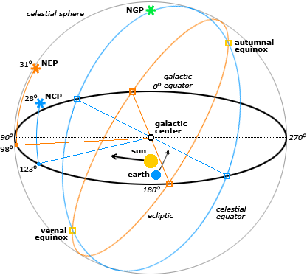
Examples - Astronomy
Coordinate system | Fundamental plane | Poles | Coordinates
Horizontal (also called Alt/Az or Az/El) | horizon | zenith/nadir | elevation (also called altitude) - azimuth - meridian
Equatorial | celestial equator | celestial poles | declination - right ascension or hour angle
A celestial coordinate system is a coordinate system for mapping positions on the celestial sphere.
The horizontal, or altitude-azimuth, system is based on the position of the observer on Earth, which revolves around its own axis once per sidereal day (23.hours, 56 minutes and 4.091 seconds) in relation to the "fixed" star background.
The equatorial coordinate system is centered at Earth's center, but fixed relative to distant stars and galaxies. The coordinates are based on the location of stars relative to Earth's equator if it were projected out to an infinite distance. The equatorial describes the sky as seen from the solar system,

Slide 14
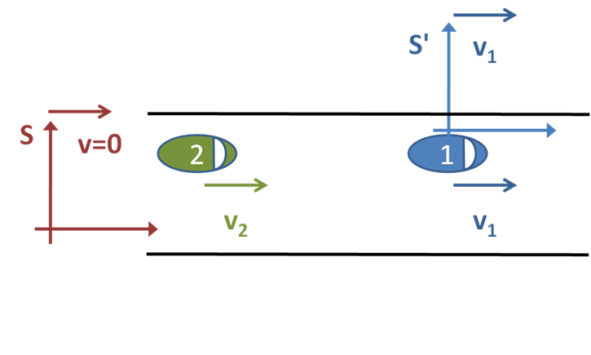
Car example
Two cars moving at different but constant velocities.
Option 1: Observed from stationary inertial frame S attached to the road
Option 2: Observed from a moving inertial frame S' attached to the first car
Distance d=200m, v1=22m/s, v2/30ms
When does car 2 catch car 1?
Solution Option 1:
Start a stop-clock at the exact moment that the second car passes us, which happens to be when they are a distance d = 200 m apart
x1(t)=d+v1*t=200+22*t
X2(t)=v2*t=30*t
200+22t=30t => t=25
Solution Option 2:
v2-v1=8m/s
d /( v₂ − v₁) = 200 / 8 s, that is, 25
=> complexity of problem description depends on frame of reference!

Slide 15
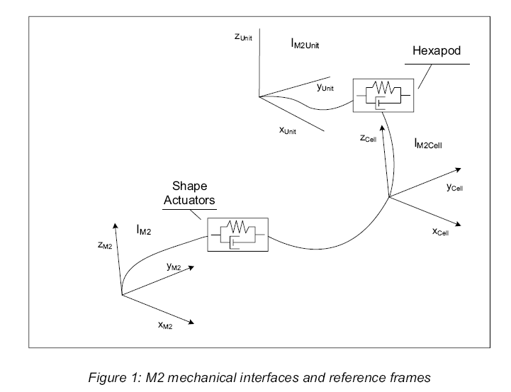
Telescope Example 1/4

Slide 16
Telescope example 2/4
"The reference frames considered in the analysis of the motion of the M2 Unit are sketched in Figure 1, where also the mechanical elements connecting the different members of the system are displayed. The motion of the optical surface is analyzed with respect to the IM2Unit reference frame. This reference frame is rigidly attached to the EELT altitude structure. The origin of this reference system is the centre of the M2 crown. The z-axis coincides with the telescope tube axis and is negative towards the primary mirror. The x-axis is parallel to the telescope altitude axis and the y-axis completes the right handed coordinate system. The IM2Cell reference frame is rigidly attached to the M2 cell. The origin of the IM2Cell is the centre of mass of the M2 cell and the main axes are, in nominal condition, parallel to the ones of the IM2Unit reference frame.“
Note: Reference frame is (probably) used here synonymously with origin of the coordinate system.

Slide 17
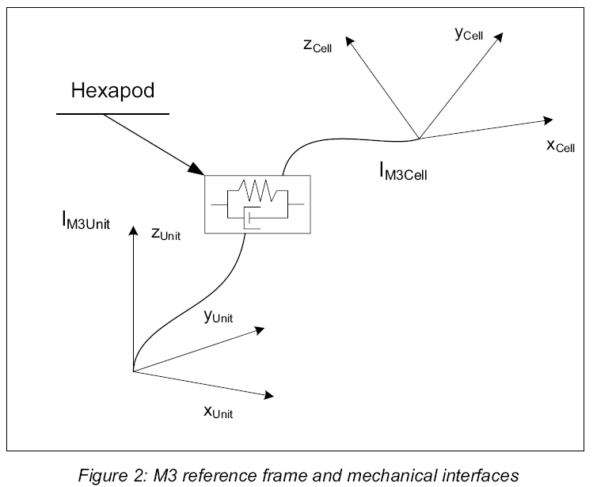
Telescope example 3/4

Slide 18
Telescope Example 4/4
"The reference frames to be used for the analysis of the M3 Unit’s motion are sketched in Figure 2 together with the mechanical interfaces between the different members of the system. In this figure, IM3Unit represents the reference frame rigidly attached to the EELT central tower. The origin is located in the plane of the support pivot-points. The z-axis coincides with the nominal optical axis of the telescope tube and is positive towards the secondary mirror. The x-axis is parallel to the nominal altitude axis. The y-axis completes the right handed frame. On the other hand, IM3Cell is the reference frame attached to the M3 cell with origin at the vertex of the optical surface of the tertiary mirror. In nominal conditions the axes of the IM3Cell reference frame are parallel to the ones of the IM3Unit reference frame.“
Note: Reference frame is (probably) used here synonymously with origin of the coordinate system.

Slide 19
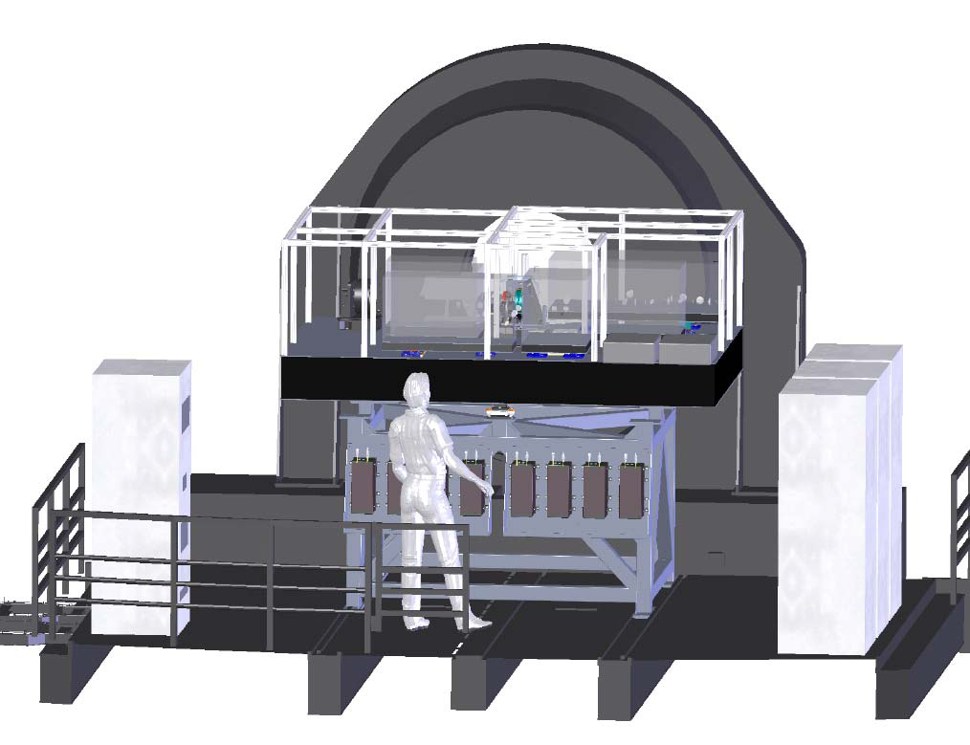
APE example

Slide 20
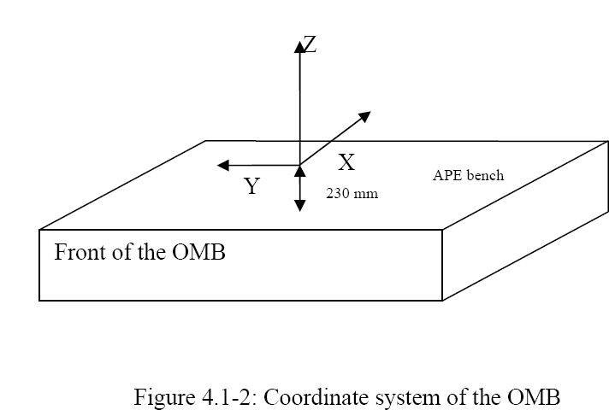
The centre of the OMB is at X=850, Y=0, Z=-230.

Slide 21
APE coordinate references
The origin of the coordinate system is the Nasmyth focus of the UT.
The surface of the APE breadboard is defined by the X and Y axis.
The X-axis is parallel and has the same direction as the optical axis of the Nasmyth focus.
The Y axis is at 90° from the X axis.
The height is defined by the Z axis.
All distances and coordinates are given in millimetre.
The coordinate system of the UT is shown on Figure 5.1-1.
The coordinate system of APE is shown on Figure 4.1-2.
The coordinate X=0, Y=0, Z=0 is the focus of the UT.
ZEUS: Allocated volume: 450*600*509 mm³, centered on X = 1467.49, Y = 375.67, Z = 0.
(Newport MRG, size 600*450*59 mm).
Alignment req.: ± 0.2 mm and ± 3 arcmin (distance and angle for all axes).
IM: Allocated volume: 600*1200*409 mm³ centered on X = 219.59, Y = 813.19, Z = 0.
ESO shall deliver the IM breadboard (Newport MRG-24-2, size 600*1200*59 mm).
Alignment req.: ± 0.2 mm and ± 3 arcmin (distance and angle for all axes)

Slide 22
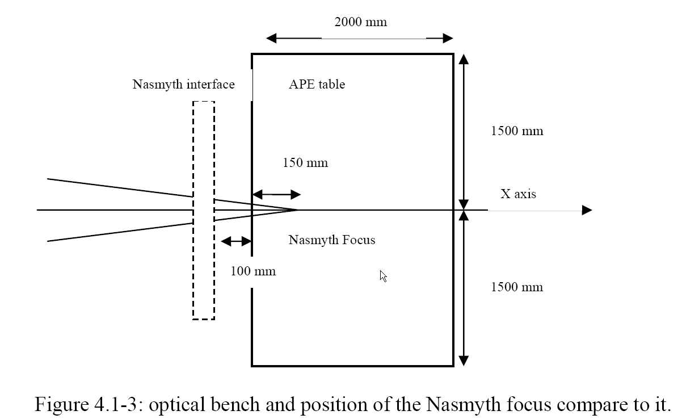

Slide 23
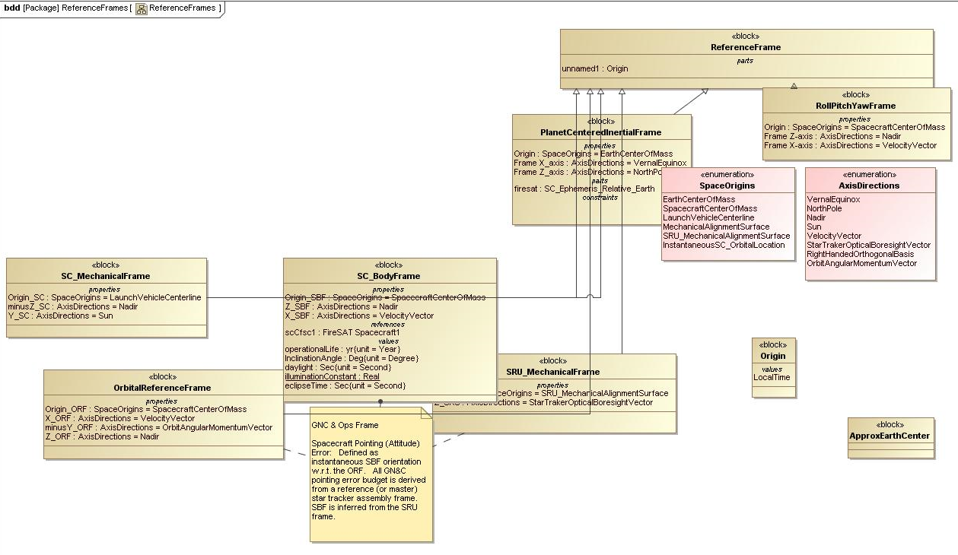
FireSat Example 1/5

Slide 24
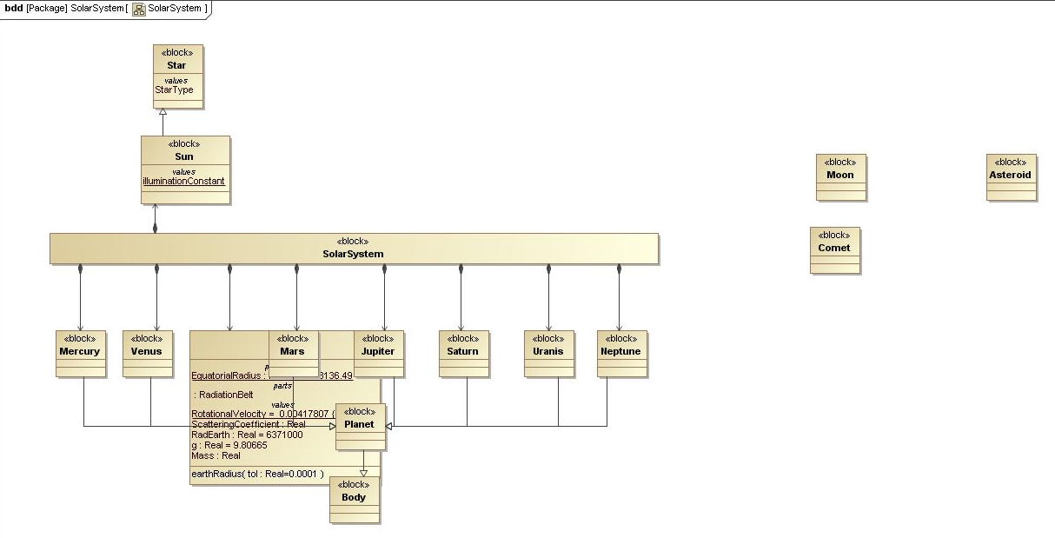
FireSat Example 2/5

Slide 25
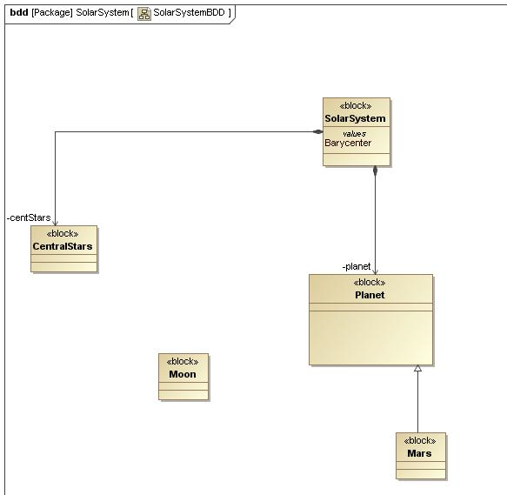
FireSat Example 3/5

Slide 26
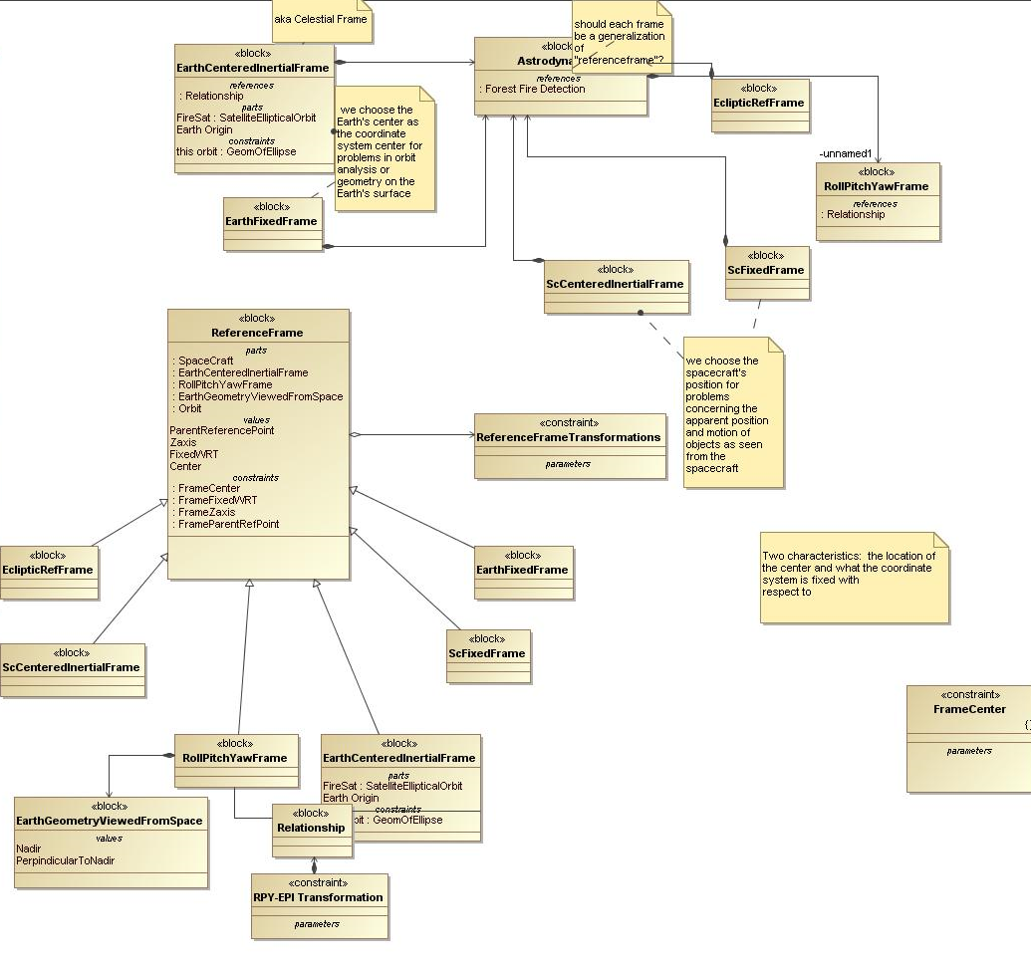
FireSat Example 4/5

Slide 27
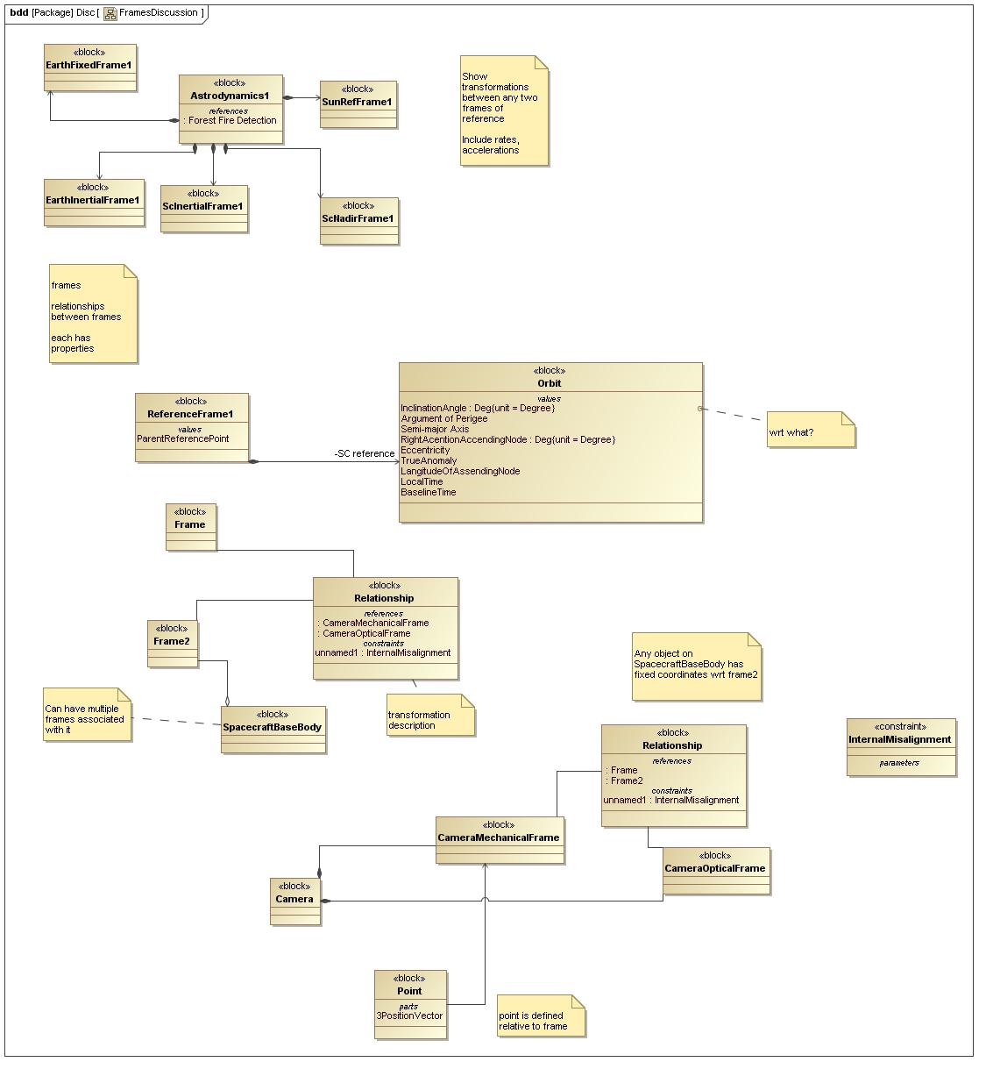
FireSat Example 5/5

Slide 28
Requirements
An Ontology to define frames of reference and coordinate systems shall be defined.
The definition of the frames of reference and coordinate systems shall be integrated in the overall system model
The definition of coordinate systems and frames of reference shall be modeled independently of model elements of the system under design; i.e. the model elements of the system under design shall remain unchanged when modeling the coordinate system, yet they shall be referenced.
The modeling approach shall permit multiple frames of reference and coordinate system for each system element.
The modeling approach shall permit to describe relations and transformations between coordinate systems; e.g. with Euler angles
The modeling concepts shall consider implementation issues, like performance of coordinate system transformation

Slide 29
Approaches in SysML
Using parametrics within a frame of reference block to define the relation to its parent in a tree allows to model all chains of transformations from one frame to another by always looking for the common parent.
Using Association blocks to model the rules is more flexible but requires more modelling overhead.
Using a pattern based approach allows to specify recursive transformation rule only once and apply it to a set of RFs. Changes need only to be done in the pattern.

Slide 30
Modeling of Relations with Euler
The Euler angles are three angles introduced describe the orientation of a rigid body
Euler angles are a means of specifying the relative orientation of two coordinate systems by simple rotation. The definition is Static.
Both coordinate system need to have the same handedness
Defined by set of angles and set of names -> necessity to define them

Slide 31
Modeling of Relations with Quaternions
a quaternion is the quotient of two directed lines in a three-dimensional space or equivalently as the quotient of two vectors
Used for calculations involving three-dimensional rotations such as in three-dimensional computer graphics and computer vision. They can be used alongside other methods, such as Euler angles and matrices, or as an alternative to them depending on the application.
Many operations on vectors can be defined in terms of quaternions, and this makes it possible to apply quaternion techniques wherever spatial vectors arise.
Expressing rotations in 3D as unit quaternions instead of matrices has some advantages:
Concatenating rotations is computationally faster and numerically more stable.
Extracting the angle and axis of rotation is simpler.
Interpolation is more straightforward.

Slide 32
Resources
SI Library / QUDV already exists for describing units and measures in a line
Unitmath libraries and associated UML models
Modeling and sim community for ideas
www.jscience.org (OGC/ISO compliant specifications)
http://jscience.org/api/org/jscience/geography/coordinates/package-summary.html

Slide 33
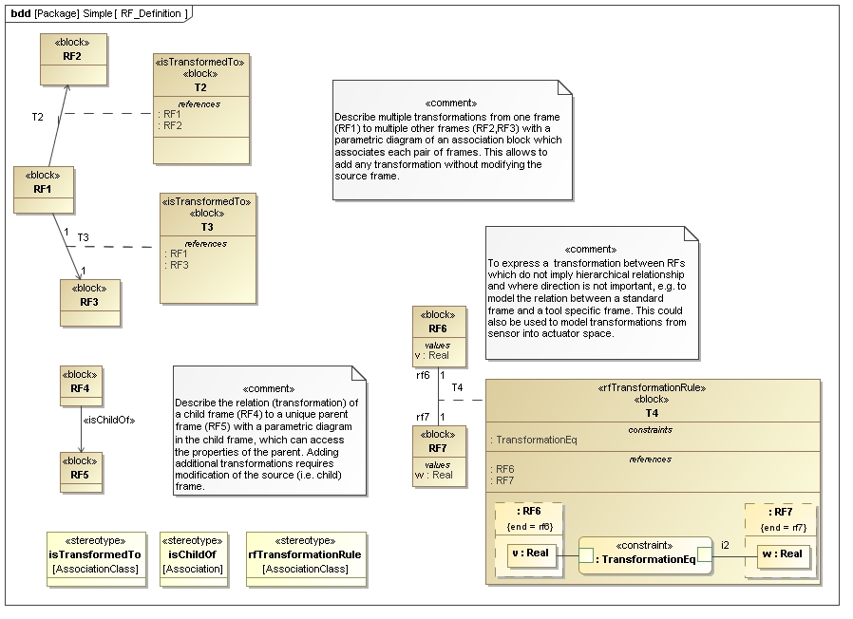
With Association Blocks

Slide 34
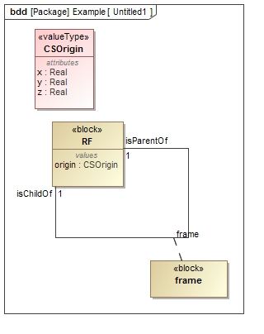

Slide 35
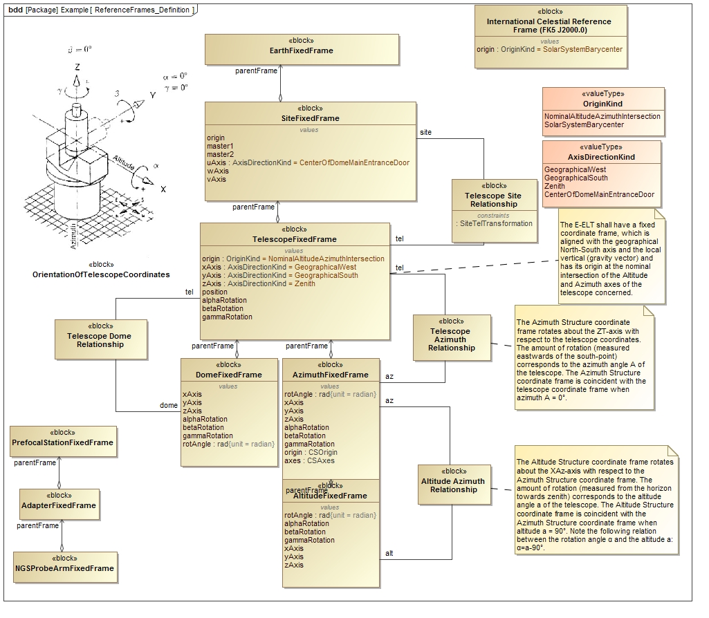

Slide 36
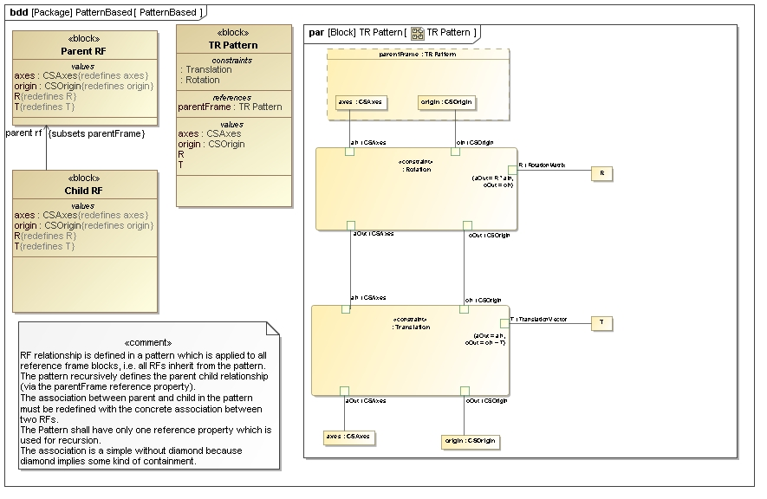
Recursive Pattern

Slide 37
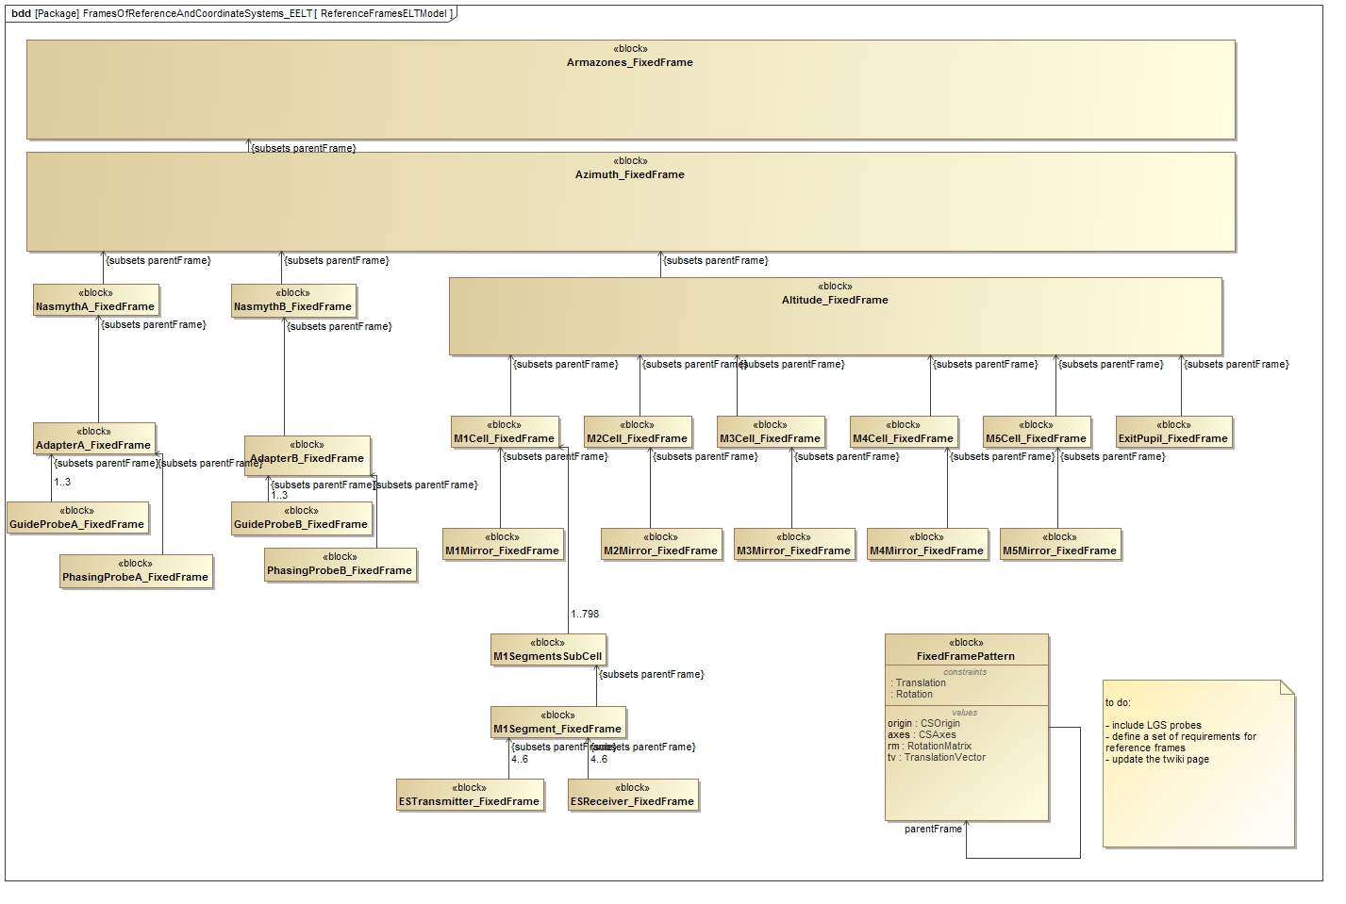
EELT example

Slide 39
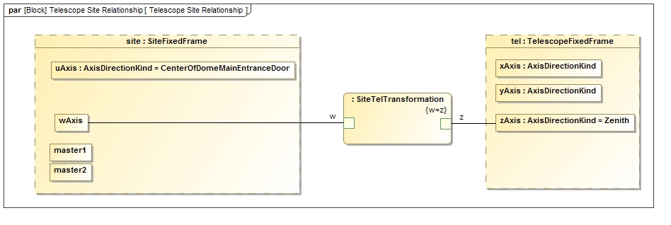

Slide 40
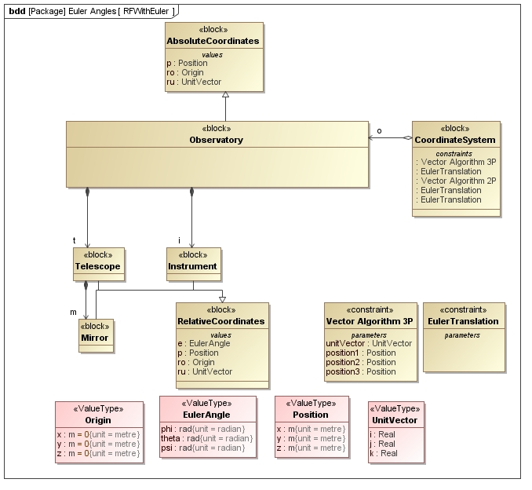
With Euler Angles

Slide 41
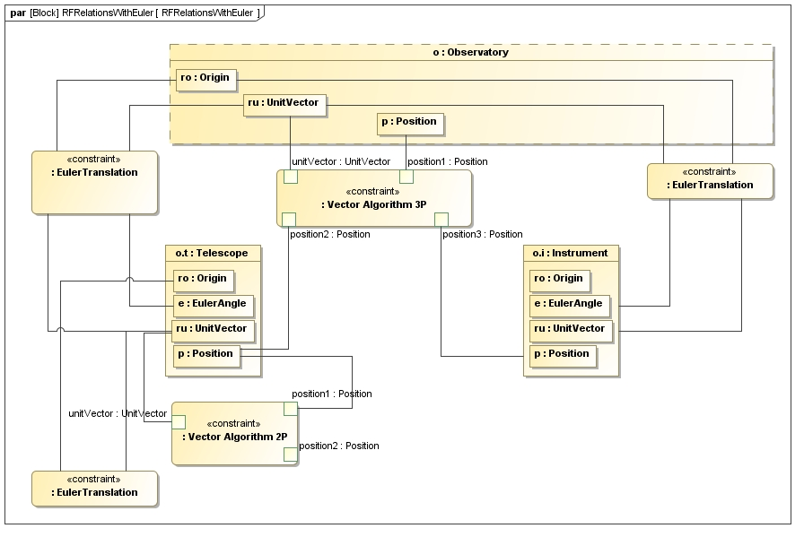

Slide 42
JPL State Analysis Graph State Variables

Slide 43
Requirement Reference Points and Relative States
A reference point may be used in the definition of one or more relative states.
Rover Arm Example
Points of Reference:
A. Rover Body
B. Upper Arm
C. Fore Arm
D. End Effector
E. Target Rock
Relative States for 6 Degree of Freedom Transformations:
End Effector wrt Rock (d or D wrt E) End Effector wrt Fore Arm (D wrt C)
Fore Arm wrt Upper Arm (C wrt B) Upper Arm wrt Rover Body (B wrt A)
Rock wrt Rover Body (E wrt A)

Slide 44
Design Nodes and Direct Relationships
A graph state variable knows about a set of uniquely identifiable nodes
and the direct relationships between its nodes.
A direct relationship is a directed edge in a graph for each a relative state.
A node is a vertex in a graph for each point of reference.
Rover Arm Example
Nodes include the reference points A, B, C, D and E.
Direct relationships are 6DOF transformations on the edges A to B, B to C, etc.
6DOF Composite
Graph State Variable

Slide 45
Requirement Derive Relative States
A relative state may be derived from others sharing common points of reference.
Rover Arm Example
Relative States for 6DOF Transformations:
D wrt E
D wrt C
C wrt B
B wrt A
E wrt A
Derivation:
End Effector wrt Rock (d or D wrt E) =
(D wrt C) • (C wrt B) • (B wrt A) • (E wrt A)⁻¹

Slide 46
Design Combine Relationships
A graph state variable computes the relationship of one of it’s nodes w.r.t. to another by combining the relationships along the path between the two nodes.
Rover Arm Example
BGSV4 can be queried for the relationship of one node with respect to another
The 6DOF transformation of the the end effector w.r.t. the rover body = BGSV4.getRelationship (A, D)
6DOF Composite
Graph State Variable

Slide 47
Design Composition
A composite GSV can combine the relationships along sub paths in its constituent graph state variables to compute the overall relationship.
Constituents may be estimated separately or be a proxy from another deployment
Rover Arm Example
The 6DOF composite GSV composed of GSVs BGSV1, BGSV2, BGSV3, BGSV4
It can be queried for the relationship of one node with respect to another node
The 6DOF transformation of the rock w.r.t. the end effector
6DOFCGSV.getRelationship (D, E) =
BGSV4.getRelationship (D, A) • BGSV2.getRelationship (A, E)
6DOF Composite
Graph State Variable

Slide 48
Requirement Multiple Derivations
A relative state may have more than one selectable derivation.
Rover Arm Example
Derivations of “End Effector wrt Rock”:
- Estimated from joint angles & rock images
(D wrt C) • (C wrt B) •
(B wrt A) • (E wrt A)⁻¹
- Estimated from end effector sensor
d
Selection:
Criteria: Use most accurate derivation
1. Use end effector sensor when close to rock, otherwise
2. Use joint angles and images of rock from rover body

Slide 49
Design Multiple Derivations
Graph state variables have a graph’s topology (rather than a tree).
A graph state variable may choose a set of derivations that satisfy an adapter supplied:
pass/fail criteria,
utility function (returns the n best), or
some combination of the two
Rover Arm Example with utility function
PositionDGSV.getRelationship (D, E, leastUncertainty,1)
e.g. use d when sensor close to rock, otherwise (D wrt C) • (C wrt B) • (B wrt A) • (E wrt A)⁻¹
6DOF Composite
Graph State Variable

Slide 50

Requirement Dynamicism
New relative states or points of reference may be added or deleted.
Earth location
wrt Sun
Spacecraft location wrt Earth
Mars location wrt Sun
Points of Reference
Mars
Earth
Sun
Spacecraft
TRAJECTORY STATES EXAMPLE
At launch
Earth location wrt Sun
Mars location wrt Sun
Spacecraft location wrt Earth

Slide 51
Requirement Dynamicism
New relative states or points of reference may be added or deleted.
Mars location
wrt Sun
Spacecraft
location
wrt Sun
Earth location
wrt Sun
Points of Reference
Mars
Earth
Sun
Spacecraft
TRAJECTORY STATES EXAMPLE
Interplanetary Cruise
Earth location wrt Sun
Mars location wrt Sun
Earth location wrt Sun
Mars location wrt Sun
Spacecraft location wrt Sun

Slide 52
Requirement Dynamicism
New relative states or points of reference may be added or deleted.
Earth location wrt Sun
Spacecraft location
wrt Mars
Mars location wrt Sun
Points of Reference
Mars
Earth
Sun
Spacecraft
TRAJECTORY STATES EXAMPLE
At Mars
Earth location wrt Sun
Mars location wrt Sun
Earth location wrt Sun
Mars location wrt Sun
Spacecraft location wrt Mars

Slide 53
Design Dynamic Topology
A graph state variable topology may be changed over time by adding or deleting nodes or direct relationships.
TRAJECTORY STATES EXAMPLE
At launch Interplanetary Cruise At Mars
Sun
Mars
location
wrt Sun
Earth location
wrt Sun
Earth
Mars
Spacecraft location
wrt Sun
Spacecraft location
wrt Mars
Spacecraft location
wrt Earth
Spacecraft

Slide 54
Additional Features
Points of Reference for Other States
A GSV node may be used to define other states
For example, a direction may be defined in terms of a coordinate frame
Shared Points of Reference
A point of reference may be used to represent different relative states for the same object
The same node may appear in GSVs that represent different states
A gyro point of reference may be used in
a 6DOF GSV to represent location and orientation
a voltage GSV
a thermal model GSV
a data bus GSV, etc...
Dependencies between Relationships
A GSV may represent correlations of knowledge among its relationships to compute the uncertainties of its derived relationships.
Performance
A GSV may form a relationship derivation, and later be asked to re-evaluate it without performing a graph search.
A GSV may incorporate search algorithm hints that incorporates domain knowledge to speed the search.

Slide 55
Powered Terminal Descent Prototype
Spacecraft Attitude and Location

Slide 56
Powered Terminal Descent Prototype
MISSION DATA SYSTEM (MDS)
03/13/2002
MBB - 56

Slide 57
Conclusions
Graph state frameworks provide a mechanism for explicitly modeling relative states.
Graph state variables provide a common reusable framework to join attitude control, navigation, and robotics.
Allow for easy management of attitude control, navigation, and robotics interactions and provide for shared systematically engineered data.
Graph state variable six degree of freedom relationships provide a common mathematical base for representing relative states for spacecraft orientation, location, trajectories, dynamics, and kinematics.
Graph state variables have been designed in an adaptable abstract model that can be adapted for the power, telecommunications, and networking domains, and possibly others.
Graph state variables provide a common framework for unambiguously and systematically describing system engineering requirements on relative states and a process for implementing them reliably in software.

